Slide 1
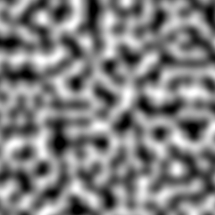
Perlin Noise
Judas Streeter

Slide 2
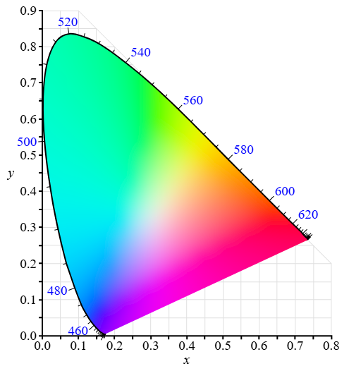
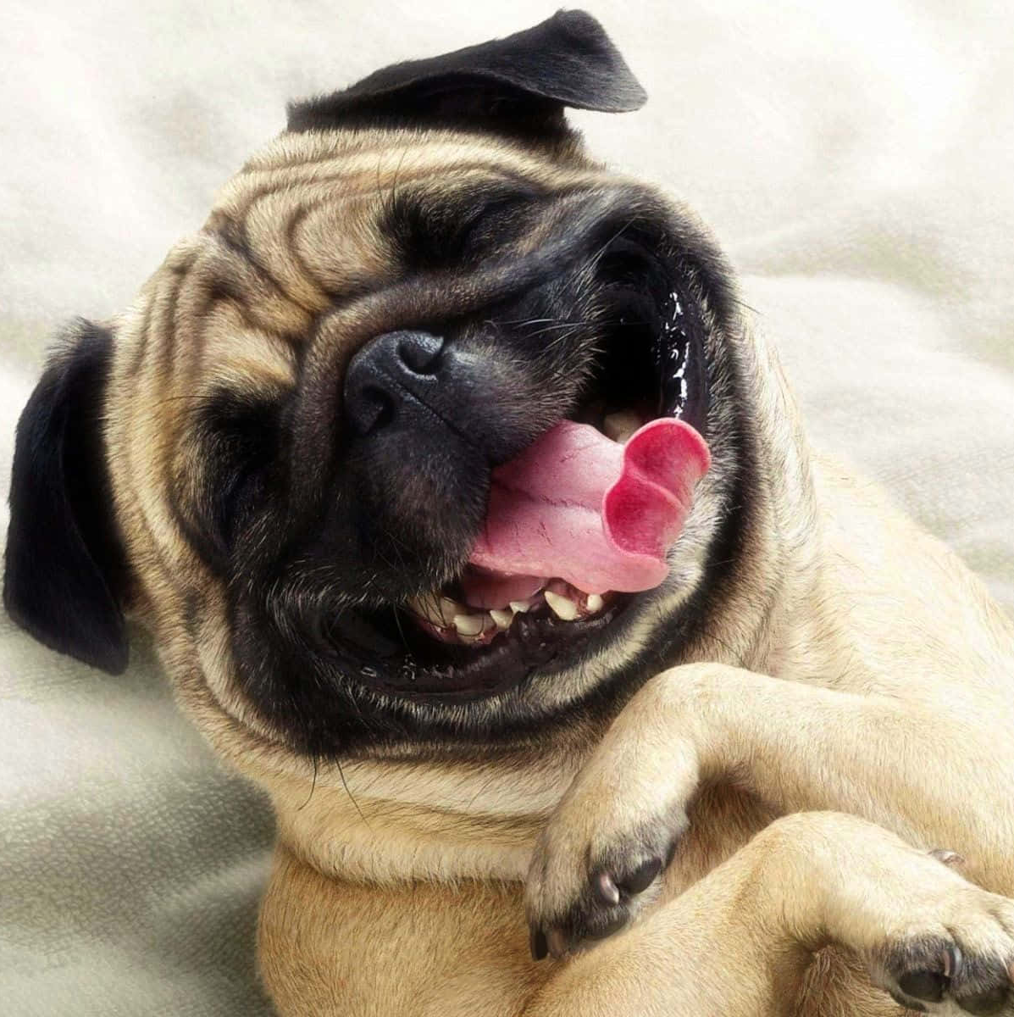

Computer Image Processing
Computer images are made up of pixels represented by vectors in a raster grid
(0, 0)
RGB
CMYK
Hex
(+ a few more)
(n, n)

Slide 3
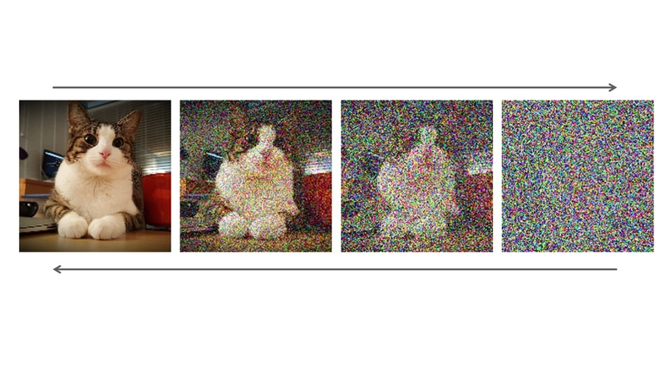
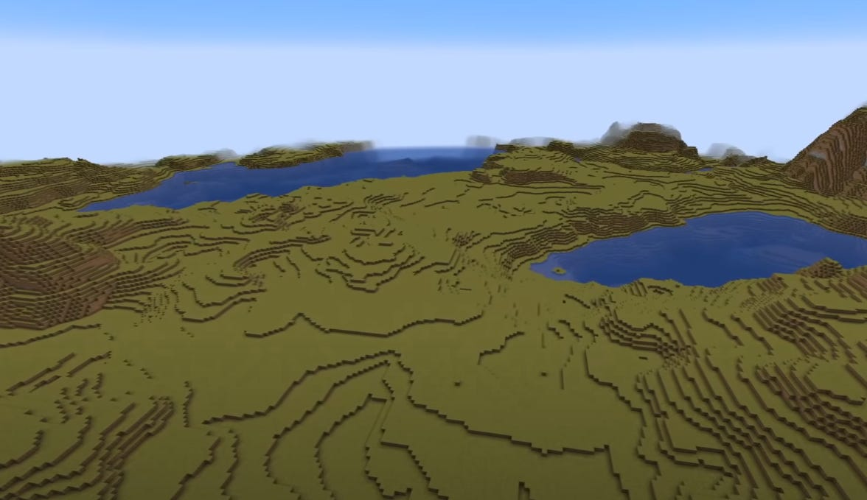
Noise Generation
Random, organic, natural

Slide 4
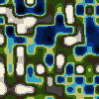

Value Noise

Slide 5
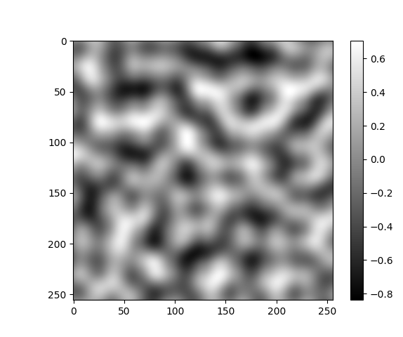
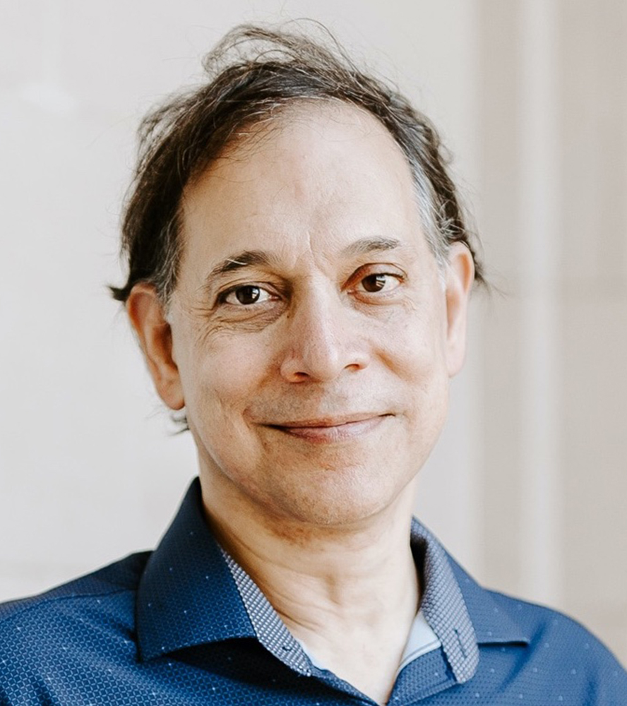
Ken Perlin, creator of Perlin Noise
Professor of Computer Science at NYU
It’s gotta be vectors!

Slide 6
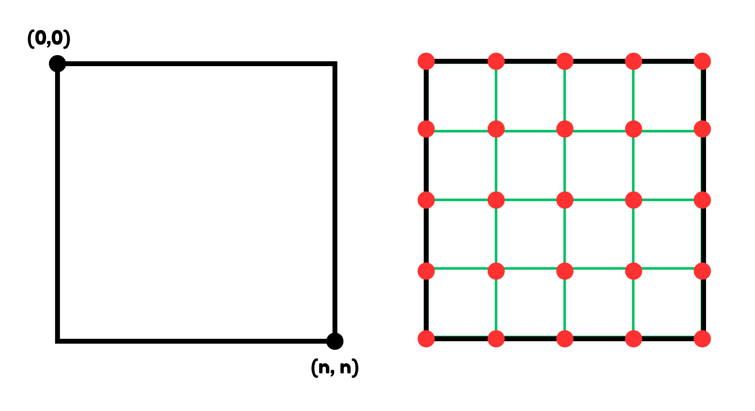
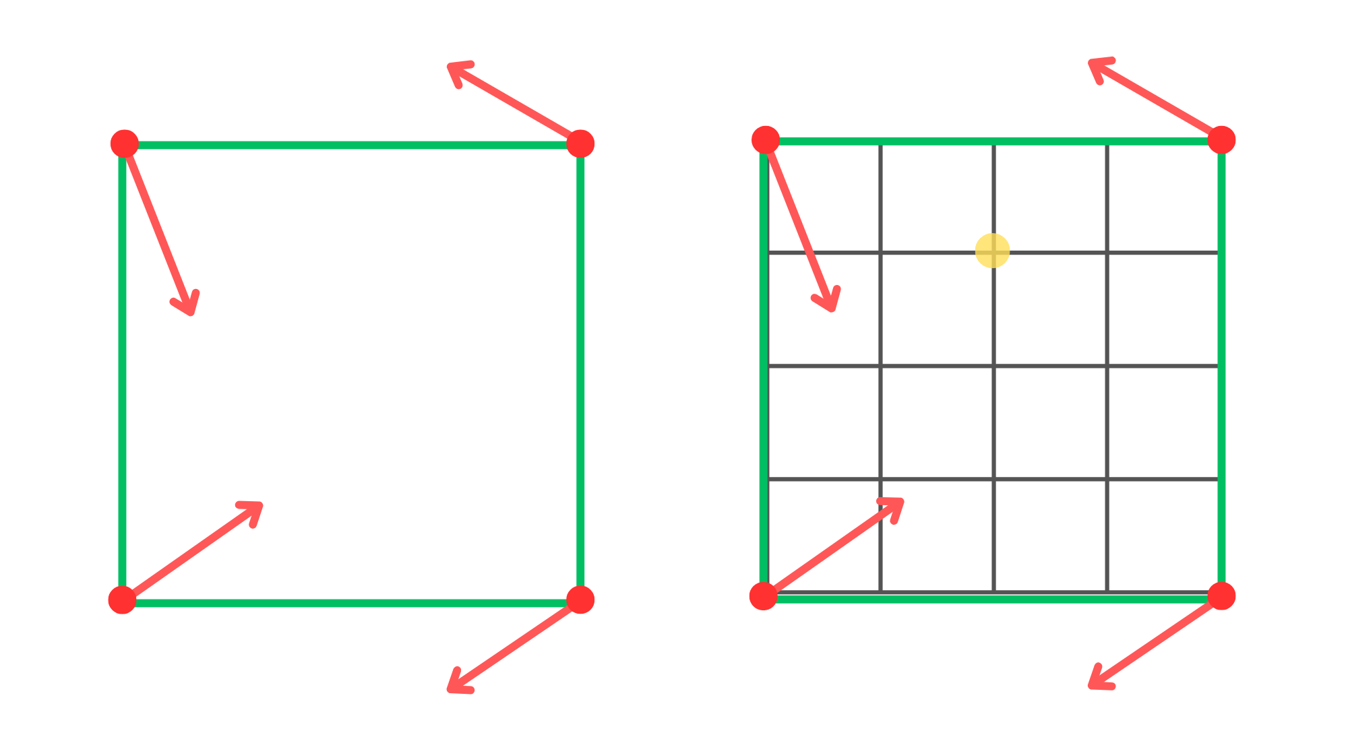
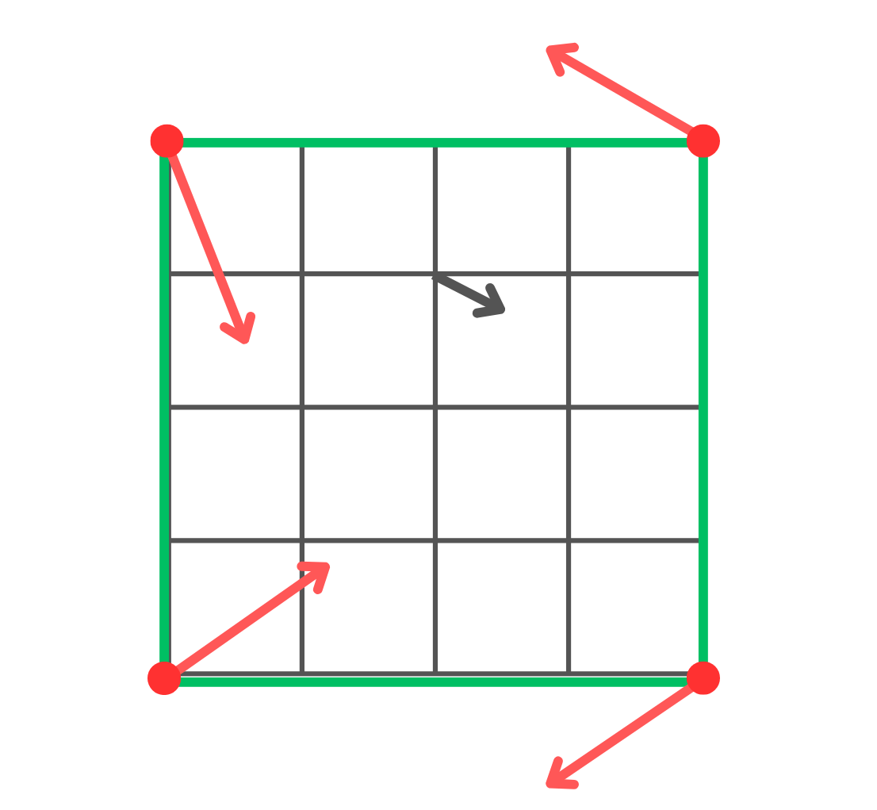
Explaining the Algorithm
Seed
RNG
2D Vector
Grid point
For each pixel:
Compute the dot products between the 4 corner vectors and the pixel
Find the average between all 4 dot products (interpolation)
Map the resulting vector to a color

Slide 7
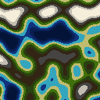
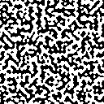

Tests and Early Attempts

Slide 8
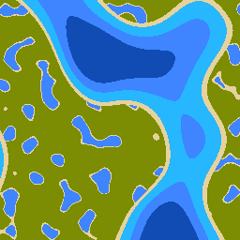
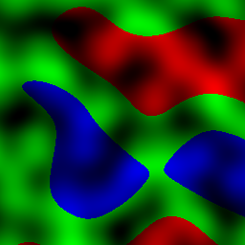
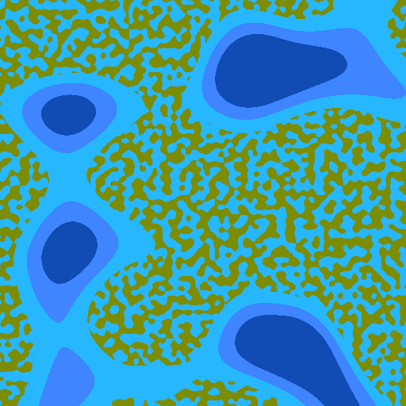
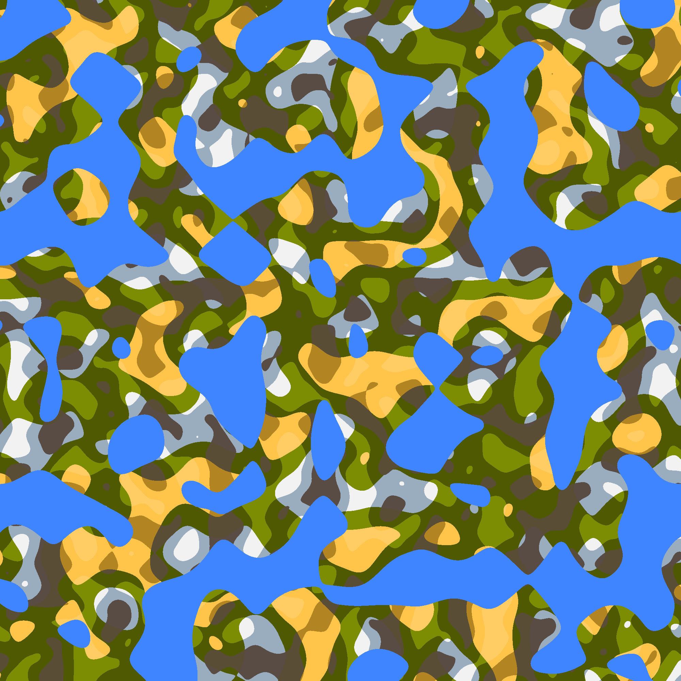
Tests and Early Attempts pt. 2

Slide 9
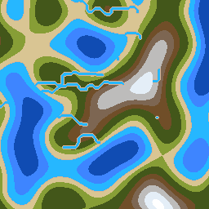


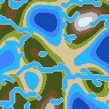
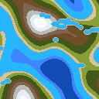
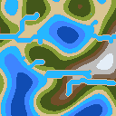

Slide 10
Thank you

